Slide 1
Four Types of Fantasy: Portal Quest, Immersive, Intrusion, and Liminal
An Introduction to the Genre

Slide 2
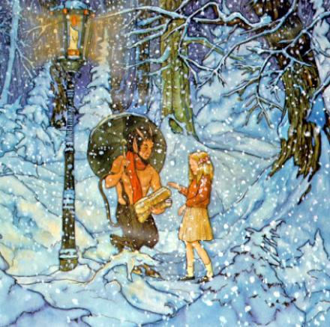
Types of Fantasy
There are four generally accepted types of fantasy: the portal-quest, the immersive, the intrusion, and the liminal.
The critical questions that determine each type are: How do we get to the fantasy? How do we meet the fantastic? In what ways does this meeting affect the narrative? Where are we asked to stand in relation to the fantastic?
http://www.craiggiven.com/images/LWW02.jpg

Slide 3
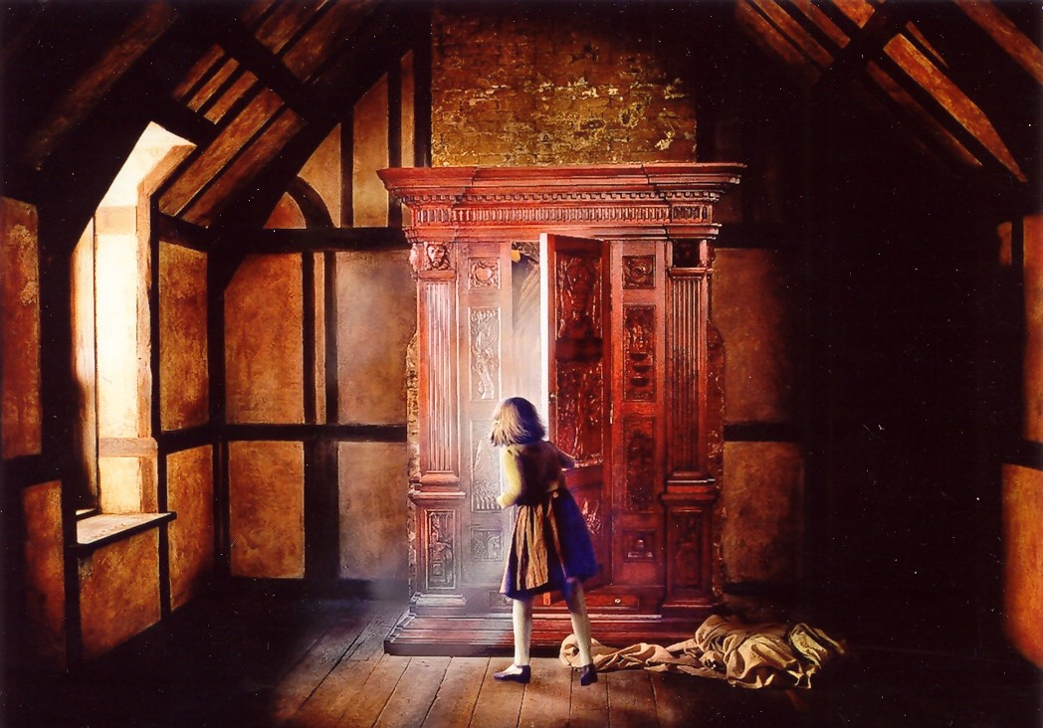
The Portal-Quest
A fantastic world entered through some sort of portal.
The classic portal fantasy is of course The Lion, the Witch and the Wardrobe (1950).
Crucially, the fantastic is on the other side and does not "leak“ through to our side. Although individuals may cross both ways, the magic does not.
http://www.henryzecher.com/NarniaWardrobe.jpg

Slide 4
The Immersive
Invites us to share not merely a world, but a set of assumptions and understandings.
At its best, it presents the fantastic as the norm both for the protagonists and for the reader: we sit on the protagonist's shoulder and while we have access to their eyes and ears, we are not provided with an explanatory narrative.
We are treated as part of that world; no attention is drawn to its strangeness.
http://volunteer.justingaylor.com/wp-content/uploads/2011/05/Dune-1.jpg

Slide 5
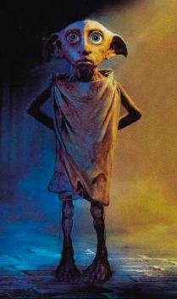
The Intrusion
The fantastic intrudes upon our world; it is the bringer of chaos.
It is the beast in the bottom of the garden (or under the bed), or the elf seeking assistance.
It takes us out of safety without taking us from our place.
The intrusion fantasy is not necessarily unpleasant BUT it assumes that when the fantastic retreats, the world returns (more or less) to predictability… at least until the next element of the fantastic intrudes.
To keep up this tone of surprise, the chaos and oddness of the intruders often escalates over the book.
http://www.hp-lexicon.org/images/film/cs/dobby-poster.jpg

Slide 6
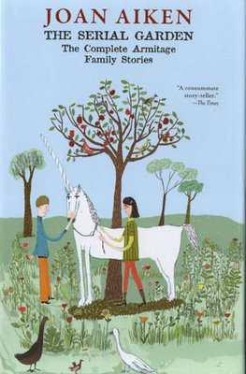
The Liminal
Similar to intrusive fantasy, set in our world.
When the fantastic appears, it should be intrusive and disruptive.
Instead, while the events themselves might be noteworthy and they may cause chaos, their magical origins barely raise an eyebrow.
Characters tend not to be surprised by the odd things, they take them as a normal part of life.
Tone can be said to be blasé and ironic.
http://3.bp.blogspot.com/_vqvrCz_OYTo/SRcfC9iC-BI/AAAAAAAACm0/kcKTwHqSc4s/s400/Serial+Garden

